Slide 1
Chapter 1: Zero to Cognitive: Design
Learning Bluemix & Cognitive
Bob Dill, IBM Distinguished Engineer, CTO Global Technical Sales

Slide 2
Objectives
Enable any one to get started easily in Bluemix/Cognitive
30 minute sessions with a couple of hours of work
Core set of sessions with additions over time to cover the core Watson APIs
Demonstrate how to integrate Watson on BlueMix
Leverage GitHub to store and find reusable starter code
Provide “Get Started” guidance
Engage directly with technical leaders on their top cognitive opportunities
IBM Bluemix is located here: https://console.ng.bluemix.net/registration/
IBM Bluemix Dedicated is located here: https://console.w3ibm.bluemix.net/
Please note that IBM Dedicated Bluemix, while available, is not recommended for experimentation. Many services, including the current Watson APIs are only available on PAID accounts. Some functionality, like Docker support, is not yet available (February, 2017).
Recommended

Slide 3
The Plan: 15-30 minute Chapters with a little practice
(Placeholder video - Real videos coming in October)
The Story, Architecture for this app
Setting up Bluemix
Building your first Watson App (Watson Speech to Text)
Getting Watson to talk back (Watson Text to Speech)
Understanding Classifiers (Watson NLC)
Creating a custom dialog with Watson (custom Q&A, session management)
Authentication (puts C2 thru 6 together)
Alchemy News (Watson Alchemy)
Visual Recognition and Images (Watson Visual Recognition)
Watson Conversations (Watson Conversations)
Rank & Retrieve (Watson Alchemy + Rank & Retrieve)
Getting started on my first client prototype Design Thinking, Stories, Architecture, Keeping it simple
Supporting Complex environments Public Bluemix and Docker
Supporting Complex environments II Bluemix Dedicated and CloudFoundry
Creating an Inference Engine Our Inference Engine in "R"
Finding solutions Integrates C1-10, 13-15)
BlueMix, Watson and Mobile (TBD)

Slide 4
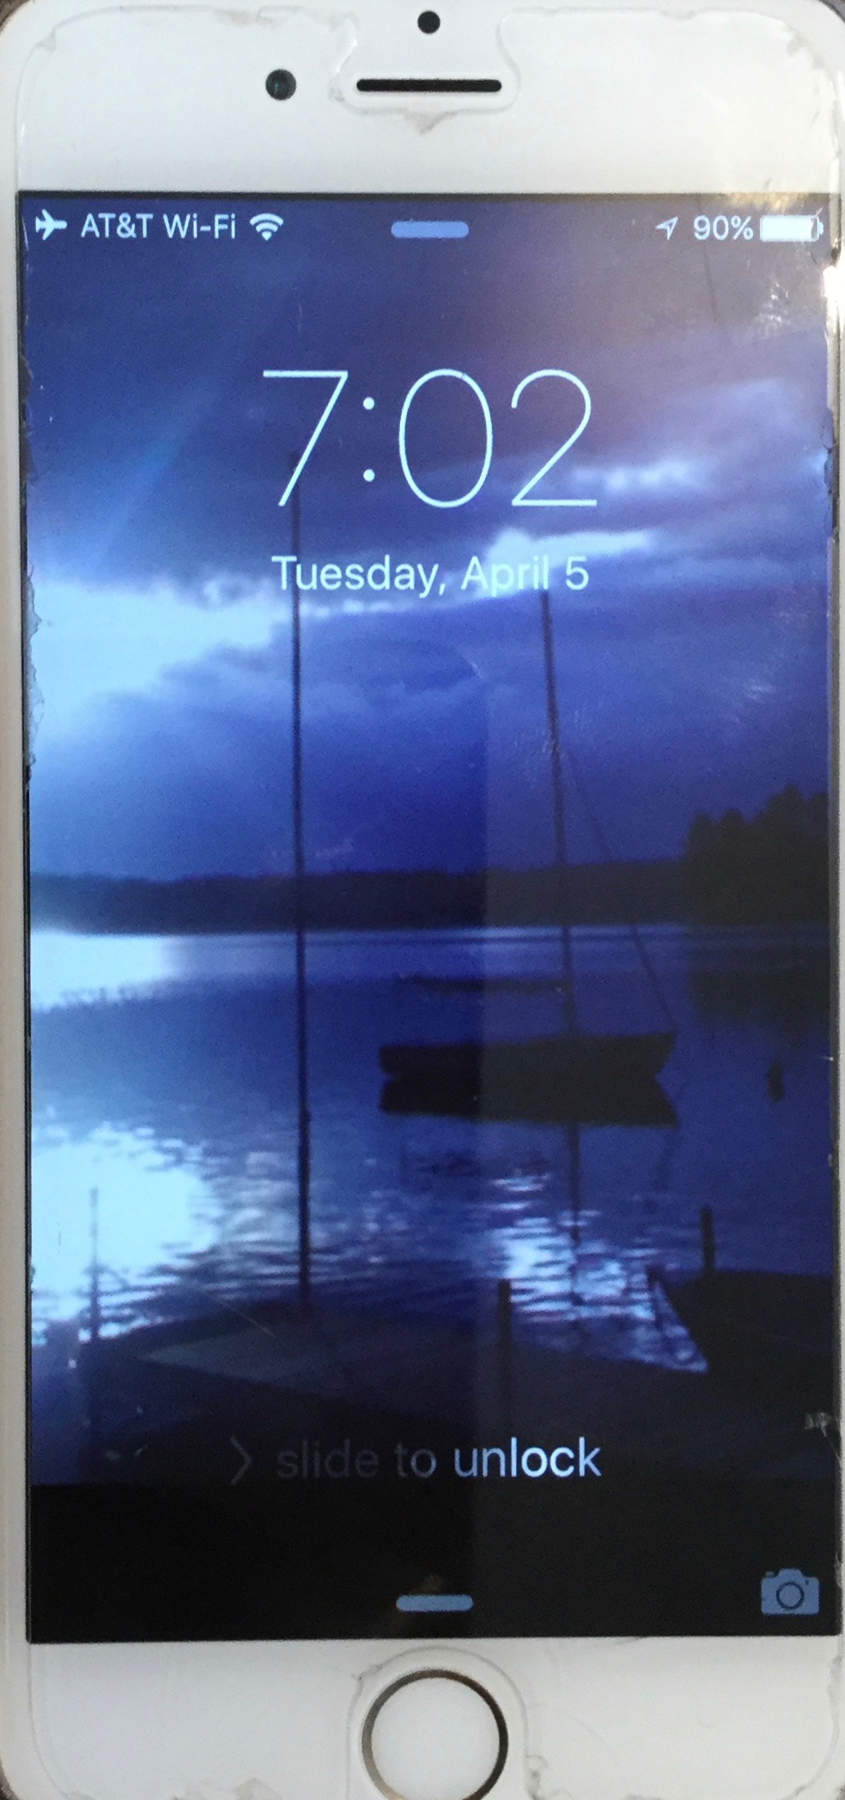
The Adviser … concept storyboard
Greeting
The Query
Results with Confidence
Hello Watson!
My CMO is struggling with results and wants to know what other companies in her geography and industry are doing. She also wants to know what companies are doing outside her industry and geography
Hello Leah, Are we working on Oncor today?
Here’s what I have found and why I think these answers will be interesting to Oncor
Got it! Give me just a moment to find some answers
Yeah.
Review
Client Discussion
Next Steps
Let’s use my iPad to look at your results.
Hello Watson!
Hello Leah, Are we working on Oncor today?
This is great. I’ll need a printout of the white paper and some of the references integrated into the first presentation.
Yes, specifically on the CMO ideas
10

Slide 5
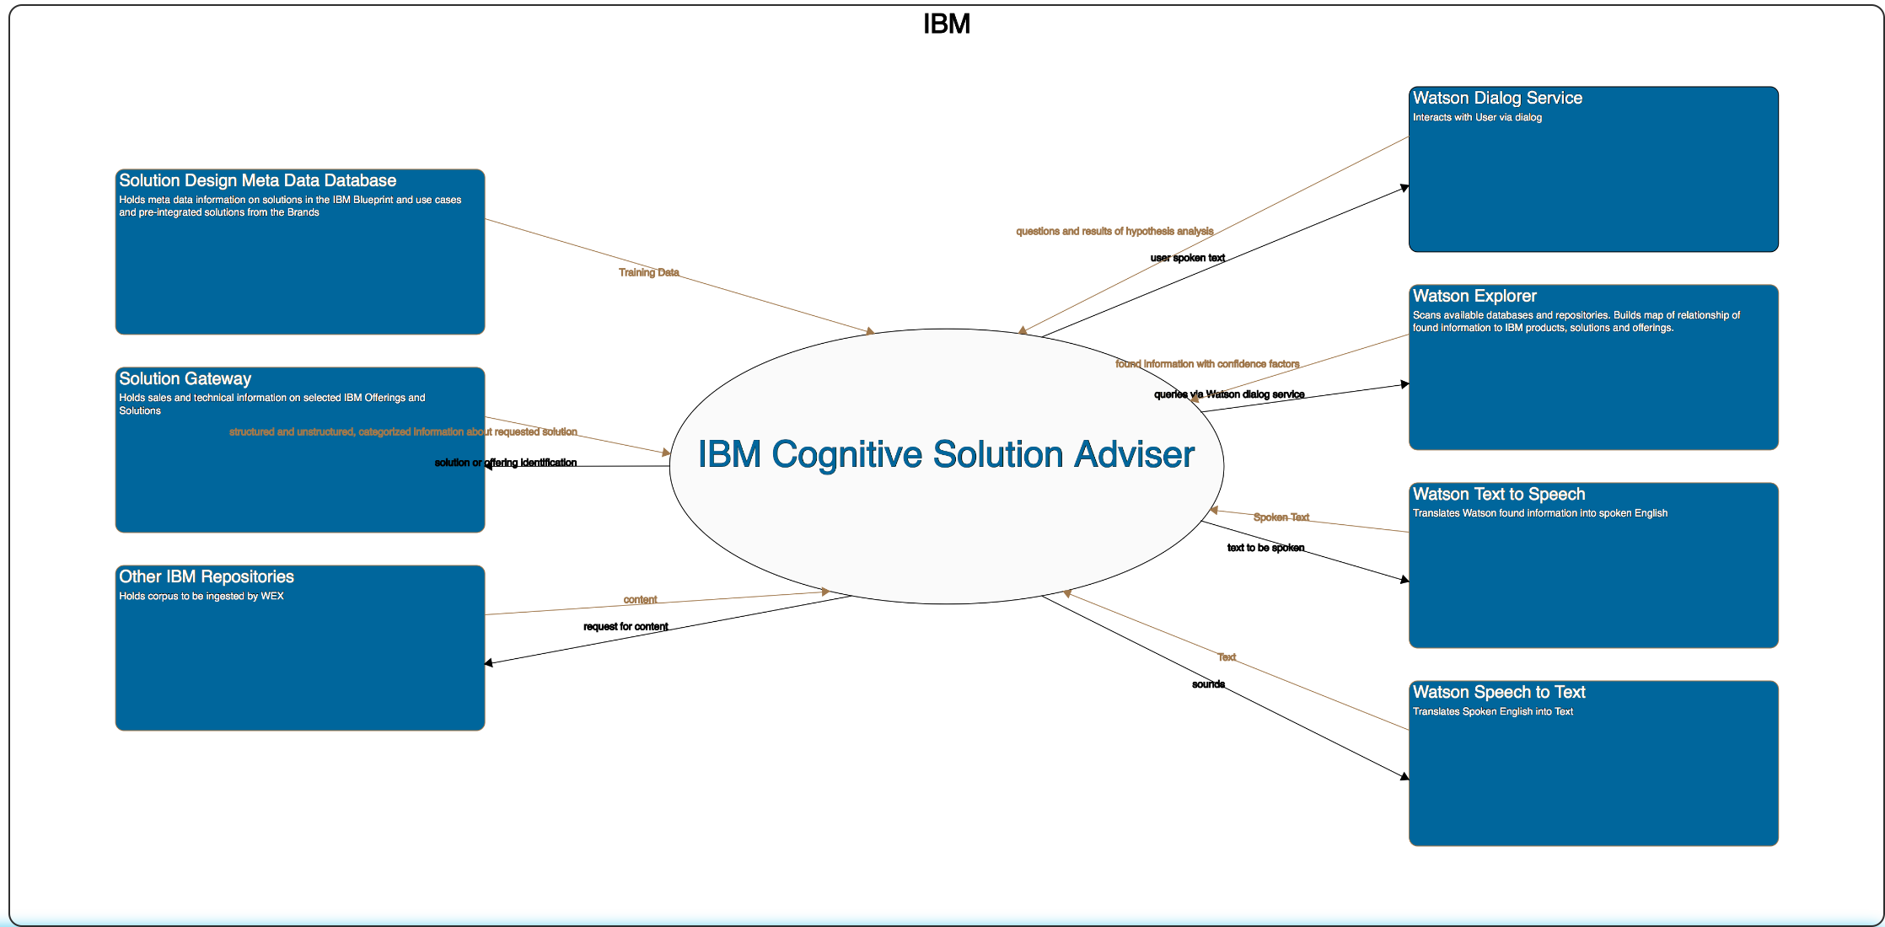
The Adviser … concept System Context
11

Slide 6
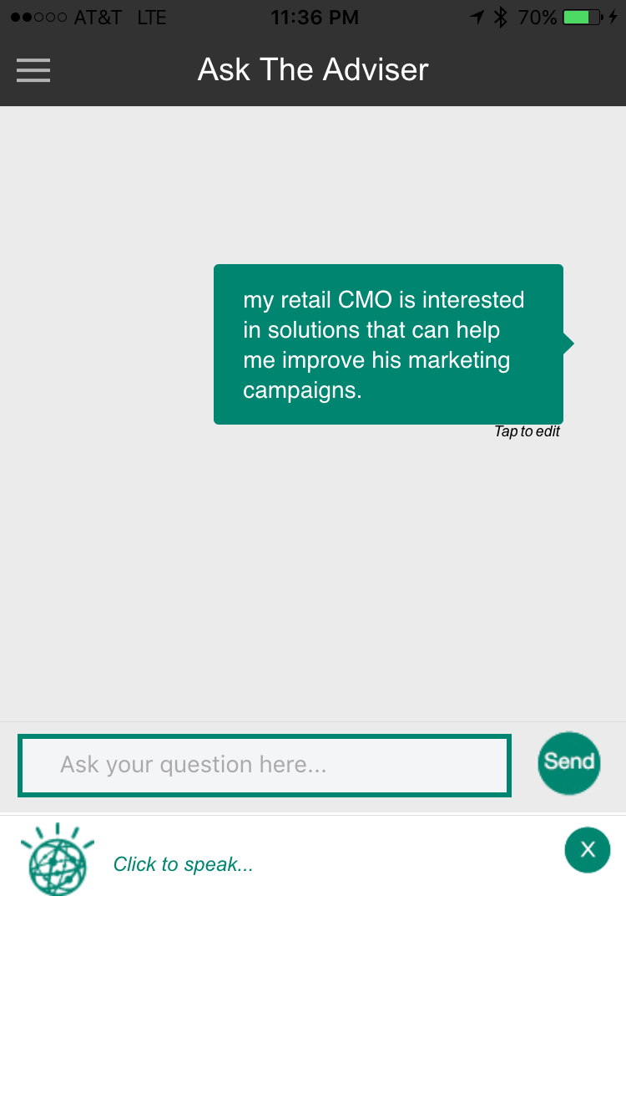

IBM Cognitive Solution Advisor Architecture, V1
Mobile App
Log in, Session Mgmt.
Watson Speech
Dialog Management
Watson NLC
Inference Engine
Watson Insights
w3
Watson Alchemy
BlueMix Dedicated

Slide 7
The Plan: 30 minute Chapters with an hour or two of practice
The Story, Architecture for this app
Setting up Bluemix
Building your first Watson App (Watson Speech to Text)
Getting Watson to talk back (Watson Text to Speech)
Understanding Classifiers (Watson NLC)
Creating a custom dialog with Watson (custom Q&A, session management)
Authentication (puts C2 thru 6 together)
Alchemy News (Watson Alchemy)
Visual Recognition and Images (Watson Visual Recognition)
Watson Conversations (Watson Conversations)
Rank & Retrieve (Watson Alchemy + Rank & Retrieve)
Getting started on my first client prototype Design Thinking, Stories, Architecture, Keeping it simple
Supporting Complex environments Public Bluemix and Docker
Supporting Complex environments II Bluemix Dedicated and CloudFoundry
Creating an Inference Engine Our Inference Engine in "R"
Finding solutions Integrates C1-10, 13-15)
BlueMix, Watson and Mobile (TBD)
September-October
4Q

